Slide 1

Web Site or desktop for LOCAL Alignment
Supervisor: DR . Sara Salah

Slide 2
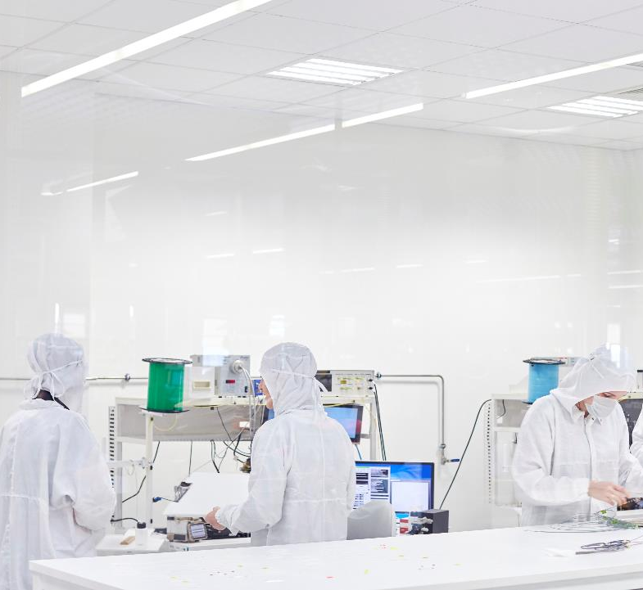
Elements
Introduction
Pairwise Sequence Alignment
Local Alignment

Slide 3
Introduction
In bioinformatics, a sequence alignment is a way of arranging the sequences of DNA, RNA, or protein to identify regions of similarity that may be a consequence of functional, structural, or evolutionary relationships between the sequences.[1] aligned sequences of nucleotide or amino acid residues are typically represented as rows within a matrix. Gaps are inserted between the residues so that identical or similar characters are aligned in successive columns. Sequence alignments are also used for non-biological sequences, such as calculating the distance cost between strings in a natural language or in financial data.

Slide 4
Pairwise Sequence Alignment
Pairwise sequence alignment is used to identify regions of similarity that may indicate functional, structural and/or evolutionary relationships between two biological sequences (protein or nucleic acid).
By contrast, multiple sequence alignment (msa) is the alignment of three or more biological sequences of similar length. From the output of MSA applications, homology can be inferred and the evolutionary relationship between the sequences studied.

Slide 5
Local Alignment
Local alignment tools find one, or more, alignments describing the most similar region(s) within the sequences to be aligned. They are can align protein and nucleotide sequences.
BLAST: Basic Local Alignment Search Tool
BLAST finds regions of similarity between biological sequences. The program compares nucleotide or protein sequences to sequence databases and calculates the statistical significance.

Slide 6
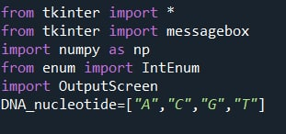
Libraries that we install

Slide 7


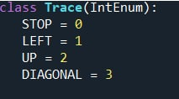

Slide 8
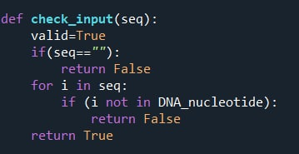

Slide 9
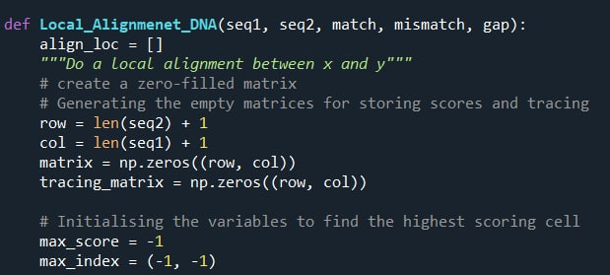
Local alignment function

Slide 10
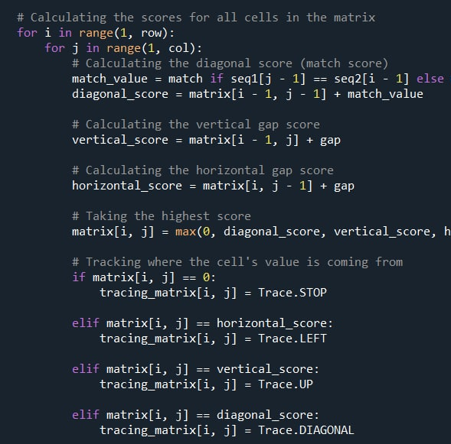
Fill in matrix

Slide 11
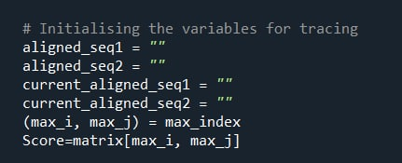
Initializing the variables for tracing

Slide 12
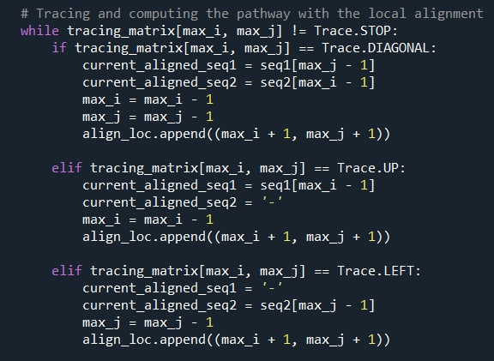
Tracing and computing the pathway

Slide 13
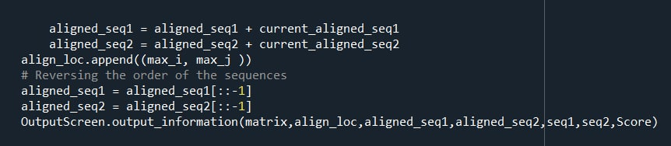
Reversing the sequence

Slide 14
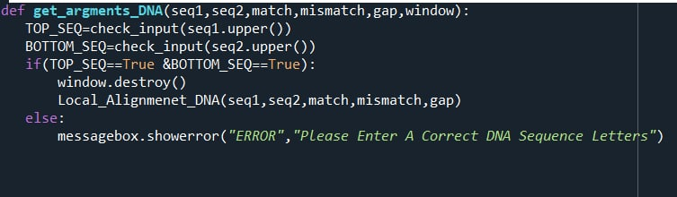
Display the sequences

Slide 15
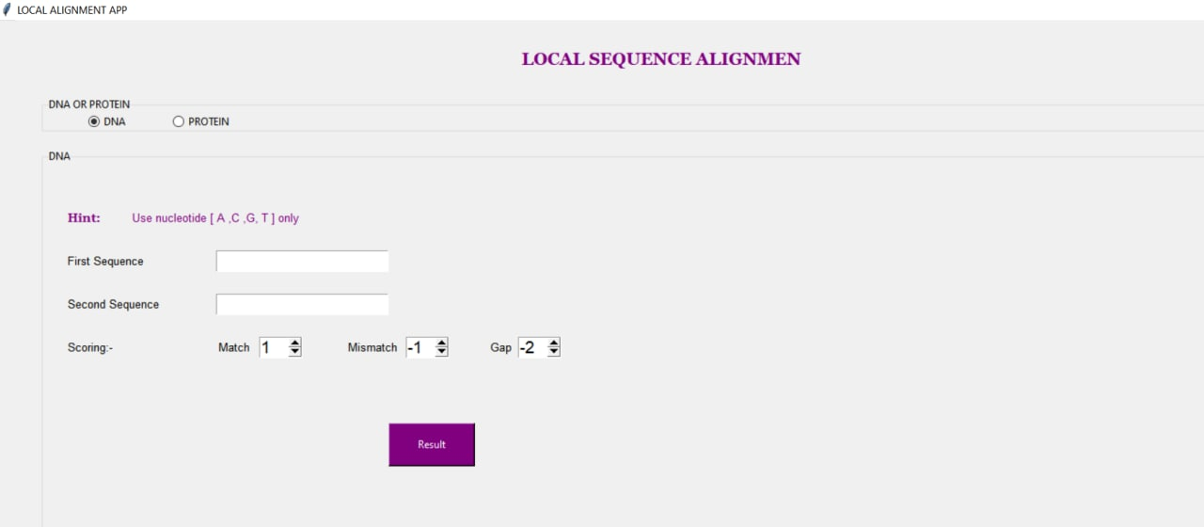
Input window

Slide 16
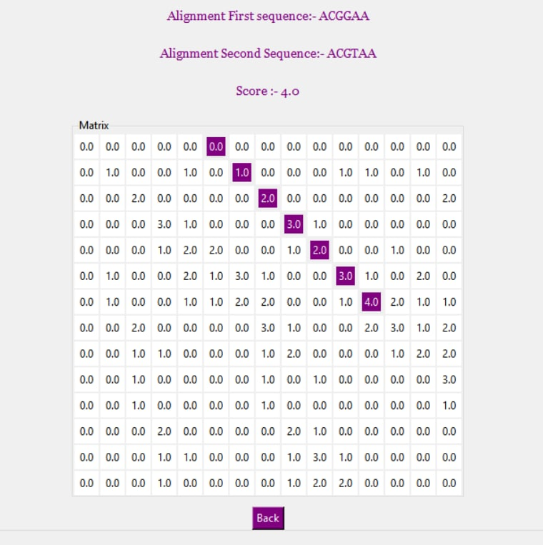
Output window

Slide 17
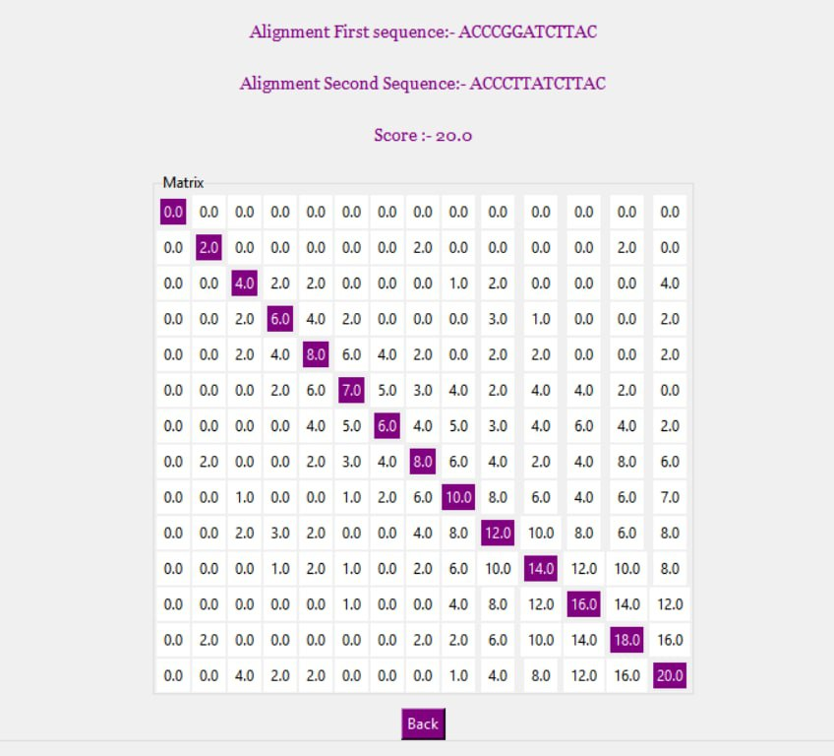
Another Output window

Slide 18

Our Team
Khloud Farouk Fouad
Nourhan Mohamed Ali
Maha Mahmoud Mohammed
Hala Khaled Mohamed
Salma Ahmed Nady
Hend Khaled Lotfy

Slide 19

Contact us
Maha.20367810@compit.Aun.Edu.Eg
Nourhanne.20367835@compit.Aun.Edu.Eg
Khloud.20367653@compit.Aun.Edu.Eg
Hind.20367841@compit.Aun.Edu.Eg
Salma.20367693@compit.Aun.Edu.Eg
Hala.20367838@compit.Aun.Edu.Eg

